Slide 1
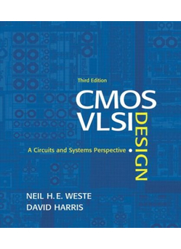
Lecture 4:
Nonideal Transistor Theory

Slide 2
Outline
Nonideal Transistor Behavior
  High Field Effects
    Mobility Degradation
    Velocity Saturation
  Channel Length Modulation
  Threshold Voltage Effects
    Body Effect
    Drain-Induced Barrier Lowering
    Short Channel Effect
  Leakage
    Subthreshold Leakage
    Gate Leakage
    Junction Leakage
Process and Environmental Variations
4: Nonideal Transistor Theory

Slide 3
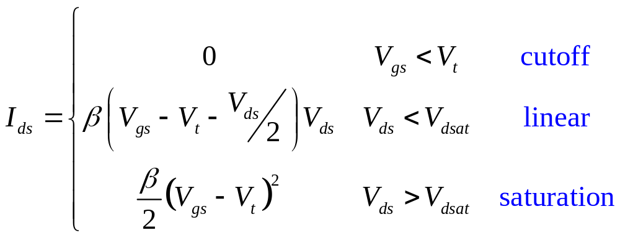
Ideal Transistor I-V
Shockley long-channel transistor models
4: Nonideal Transistor Theory

Slide 4
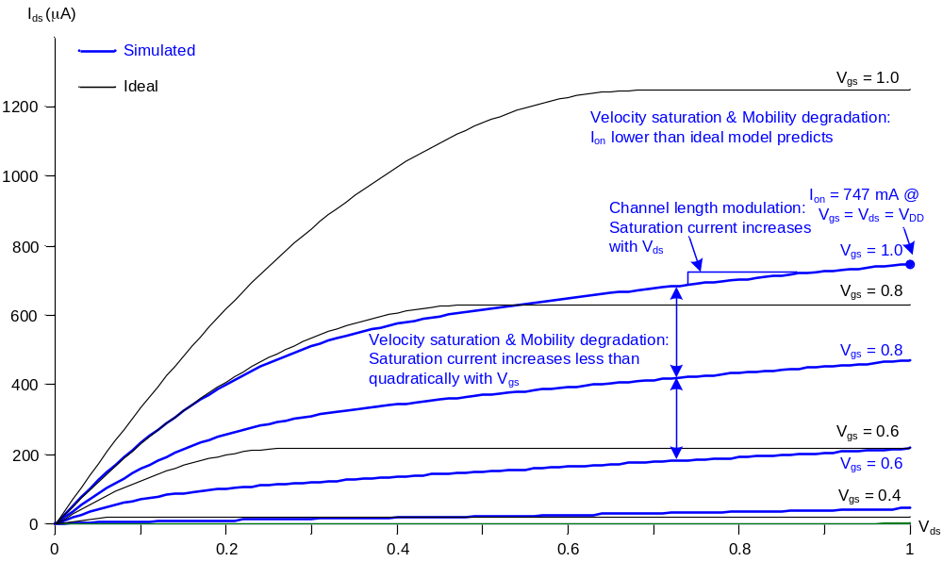
Ideal vs. Simulated nMOS I-V Plot
65 nm IBM process, V_{DD} = 1.0 V
4: Nonideal Transistor Theory
Notes:
Ion (defined in the next slide): = I_{ds} @ V_{gs} = V_{ds} = V_{DD} (=Isat @ V_{gs} = V_{ds} = V_{DD} ). Eg: Vgs = Vds = Vdd=1.0 V, Ids at this point is called Ion
Velocity saturation & Mobility degradation:
1. Ion: By the same Vgs, Ion of simulated plot (non-ideal) is lower than ideal model predicted (calculated by equations in last lecture)
2. Isat: By the equation in last lecture, Isat increases quadratically with Vgs, but in simulated plot (non-ideal) Isat increases less than quadratically with Vgs
Channel length modulation:
By the equation in last lecture, I sat does not increase with Vds, but in simulated plot (non-ideal) Isat increases with Vds

Slide 5
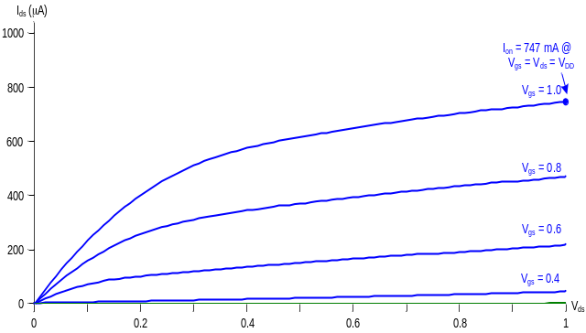
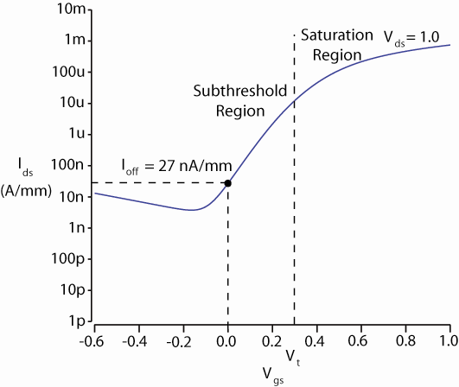
ON and OFF Current
I_{on} = I_{ds} @ V_{gs} = V_{ds} = V_{DD}
  Saturation
I_{off} = I_{ds} @ V_{gs} = 0, V_{ds} = V_{DD}
  Cutoff
4: Nonideal Transistor Theory
Notes:
Ion (defined in the next slide): = I_{ds} @ V_{gs} = V_{ds} = V_{DD} (=Isat @ V_{gs} = V_{ds} = V_{DD} ). Eg: Vgs = Vds = Vdd=1.0 V, Ids at this point is called Ion

Slide 6
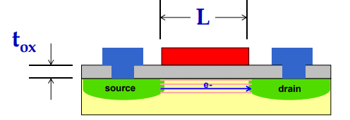
Electric Fields Effects
Vertical electric field: E_{vert} = V_{gc} / t_{ox} = (V_{gs} - V_{ds} /2)/ t_{ox}
  Attracts carriers into channel
  Long channel: Q_{channel} ∝ E_{vert}
Lateral electric field: E_{lat} = V_{ds} / L
  Accelerates carriers from drain to source
  Long channel: v = μE_{lat}
4: Nonideal Transistor Theory
Notes:
Vgc = Vg – Vc = Vg – (Vs+Vds/2) = Vgs – Vds/2
v = Muy*Elat: For Elat small => Ids increase linearly with the Elat
But, for Elat large, v = Slide 9

Slide 7
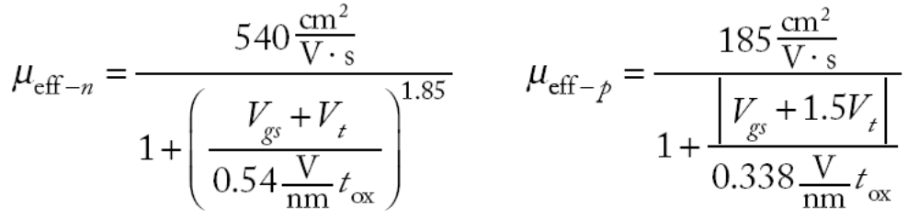
Mobility Degradation
High E_{vert} effectively reduces mobility
  Collisions with oxide interface
4: Nonideal Transistor Theory
Notes:
Ideality, Muy is independent from Vgs and Vt
Reality, Muy is decreased when Vgs increases

Slide 8
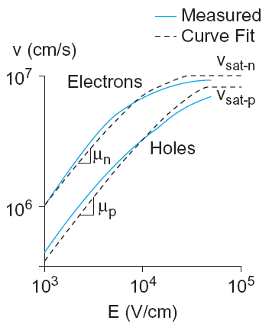
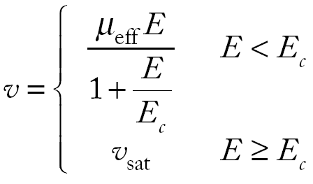
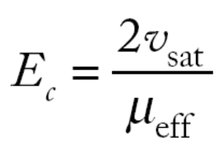
Velocity Saturation
At high E_{lat}, carrier velocity rolls off
  Carriers scatter off atoms in silicon lattice
  Velocity reaches v_{sat}
    Electrons: 10⁷ cm/s
    Holes: 8 x 10⁶ cm/s
  Better model
_{E đang nói tới là Elat}
4: Nonideal Transistor Theory
Notes:
Ideality, v = Muy*Elat => Ids increase linearly with the Elat
Reality, v = Muy*Elat/(1+Elat/Esat), where Esat is determined empirically => v in reality is smaller than v in ideality => Ids in reality is smaller than Ids in ideality

Slide 9
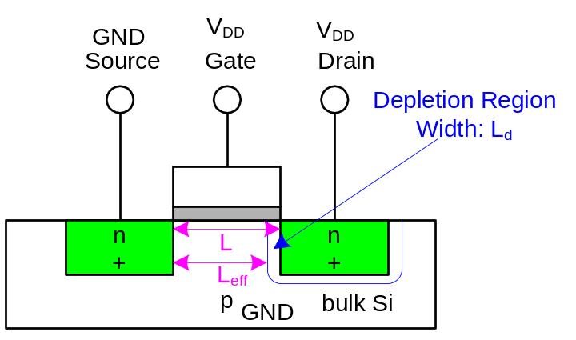
Channel Length Modulation
Reverse-biased p-n junctions form a depletion region
  Region between n and p with no carriers
  Width of depletion L_{d} region grows with reverse bias
  L_{eff} = L – L_{d}
Shorter L_{eff} gives more current
  I_{ds} increases with V_{ds}
  Even in saturation
4: Nonideal Transistor Theory

Slide 10
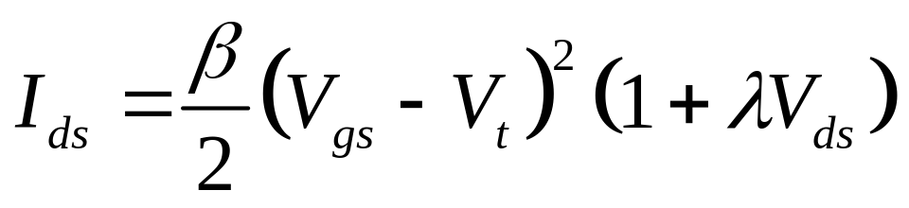
Chan Length Mod I-V
λ = channel length modulation coefficient
  not feature size
  Empirically fit to I-V characteristics
4: Nonideal Transistor Theory

Slide 11
Threshold Voltage Effects
V_{t} is V_{gs} for which the channel starts to invert
Ideal models assumed V_{t} is constant
Really depends (weakly) on almost everything else:
  Body voltage: Body Effect
  Drain voltage: Drain-Induced Barrier Lowering
  Channel length: Short Channel Effect
4: Nonideal Transistor Theory
Notes:
Ideality, Vt is constant
Reality, Vt is not constant, it is changed by Vsb, Vd

Slide 12

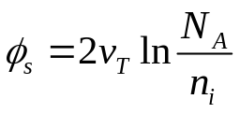
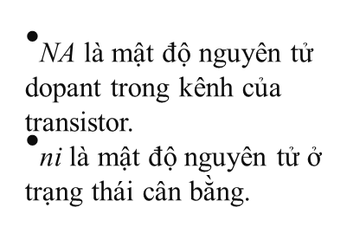
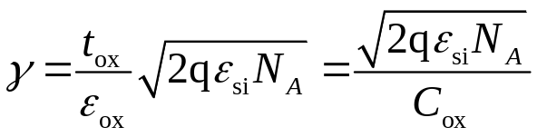
Body Effect
Body is a fourth transistor terminal
V_{sb} affects the charge required to invert the channel
  Increasing V_{s} or decreasing V_{b} increases V_{t}
φ_{s} = surface potential at threshold
  Depends on doping level N_{A}
  And intrinsic carrier concentration n_{i}
γ = body effect coefficient
4: Nonideal Transistor Theory

Slide 13
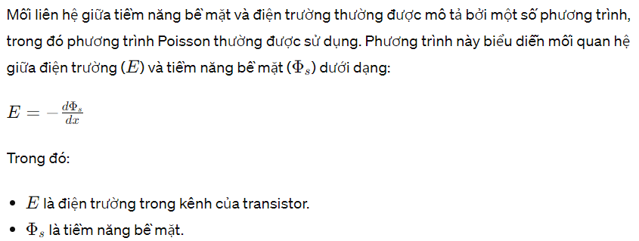
Body Effect
4: Nonideal Transistor Theory

Slide 14
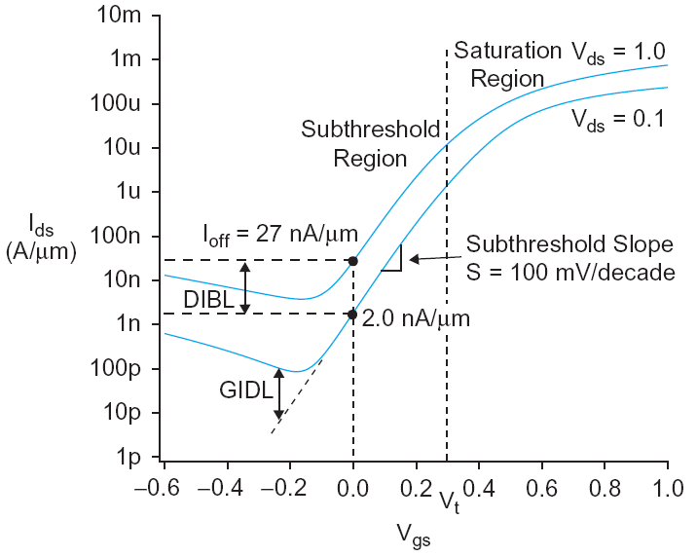

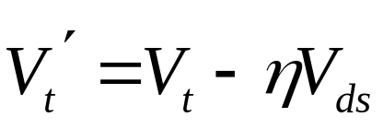
DIBL
Electric field from drain affects channel
More pronounced in small transistors where the drain is closer to the channel
Drain-Induced Barrier Lowering
  Drain voltage also affect V_{t}
High drain voltage causes current to increase.
4: Nonideal Transistor Theory

Slide 15
Short Channel Effect
In small transistors, source/drain depletion regions extend into the channel
  Impacts the amount of charge required to invert the channel
  And thus makes V_{t} a function of channel length
Short channel effect: V_{t} increases with L
  Some processes exhibit a reverse short channel effect in which V_{t} decreases with L
4: Nonideal Transistor Theory
Notes:
L tăng thì cần lượng điện tích lớn hơn để hình thành kênh dẫn => Vt lớn hơn

Slide 16
Leakage
What about current in cutoff?
Simulated results
What differs?
  Current doesn’t
  go to 0 in cutoff
4: Nonideal Transistor Theory

Slide 17
Leakage Sources
Subthreshold conduction
  Transistors can’t abruptly turn ON or OFF
Gate leakage
  Tunneling through ultrathin gate dielectric
  Tunneling current thông qua cách điện cổng tạo ra một dạng dòng rò, làm tăng tiêu thụ điện năng không mong muốn và làm giảm hiệu suất của transistor.
  Hiệu ứng tunneling có thể làm giảm điện áp ngưỡng cần thiết để kích hoạt transistor, do electron tunneling đã tạo ra một số electron dư thừa trong kênh, tạo ra một dòng dẫn dòng điện nhỏ ngay cả khi điện áp cổng nhỏ
Junction leakage
  Reverse-biased PN junction diode current
4: Nonideal Transistor Theory

Slide 18
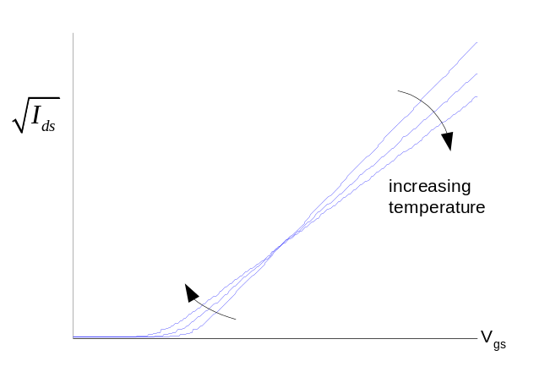
Temperature Sensitivity
Increasing temperature
  Reduces mobility
  Reduces V_{t}
I_{ON} decreases with temperature
I_{OFF} increases with temperature
4: Nonideal Transistor Theory

Slide 19
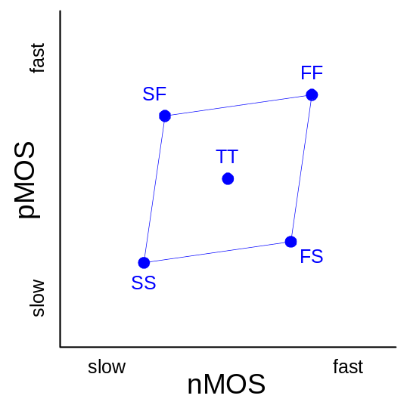
Parameter Variation
Transistors have uncertainty in parameters
  Process: L_{eff}, V_{t}, t_{ox} of nMOS and pMOS
  Vary around typical (T) values
Fast (F)
  L_{eff}: short
  V_{t}: low
  t_{ox}: thin
Slow (S): opposite
Not all parameters are independent
for nMOS and pMOS
4: Nonideal Transistor Theory

Slide 20
Process Corners
Process corners describe worst case variations
  If a design works in all corners, it will probably work for any variation.
Describe corner with four letters (T, F, S)
  nMOS speed
  pMOS speed
  Voltage
  Temperature
4: Nonideal Transistor Theory

